Slide 1
Data Mining Applied to Major League Baseball Batters
Michael Taylor
CS 522: Data Mining
Hood College, Computer Science Department
Frederick, Maryland, USA

Slide 2
Baseball Basics
When a pitcher pitches the ball to the batter, there can be one of four outcomes:
  A hit
  A strike
  A ball
  A foul ball

Slide 3
Baseball Basics Continued
A hit occurs when the batter makes contact with the ball and the ball travels through the fair area of the ball park, which is designated by the white lines on the field
A strike occurs when the pitcher pitches through the designated strike zone, without the batter making contact with the ball
A ball occurs when the ball misses the strike zone and the batter does not swing at the ball
A foul ball occurs when the batter makes contact with the ball, and the ball is hit outside of the fair play area

Slide 4
Strike Zone
This data mining experiment focuses on the area in which a batter most often hit the ball, which may or may not always fall within the strike zone
The strike zone changes slightly depending on the player’s stance, height, and referee’s call
The strike zone is generally located over home plate beginning just below the batter’s knee and ending below their shoulders

Slide 5
Pitch Types
Fast Balls:
FA = fastball
FF = four-seam fastball
FT = two-seam fastball
FC = fastball (cutter)
FS / SI / SF = fastball (sinker, split-fingered)

Slide 6
Pitch Types Continued
Off- Speed:
SL = slider
CH = changeup
CB / CU = curveball
KC = knuckle-curve
KN = knuckleball
EP = eephus
Other:
UN / XX = unidentified
PO / FO = pitch out

Slide 7
Purpose of Experiment
To extrapolate predictive analysis from current baseball statistics
To seek out simpler and possibly better solutions to the age old problem of where to pitch the ball for a specific outcome
We will look into each batter's success based upon pitch type and pitch location, using cluster analysis and association rules

Slide 8
Use of Statistics in MLB
Baseball has always been a sport that has relied on statistics to:
  Evaluate a player’s performance
  Create defensive plays based on past player interactions
  Predict future plays based on past situations

Slide 9
Background
The official start of Major League Baseball began in 1903 with the combination of the National League and American League.
grown to be a multi-billion dollar industry.
long seasons and multiple at bats per game
the volume of data becomes massive.
Use Of statistics
Every at bat is important

Slide 10
Approach and Methodology
For the sake of this experiment data has been gathered for the current Major League Baseball season from the website: http://gd2.mlb.com/components/game/mlb/year_2015/
After the data is collected it will be inserted in an SQL data base

Slide 11
SQL Database
Field | Type | Null | Key | Default | Extra
id | varchar(50) | Yes |  | Null
name | varchar(50) | Yes |  | Null
des | varchar(50) | Yes |  | Null
pitch_type | varchar(50) | Yes |  | Null
x | Float | Yes |  | Null
y | Float | Yes |  | Null
start_speed | Float | Yes |  | Null
end_speed | Float | Yes |  | Null

Slide 12
Database definitions
id: Unique identify for each player.
name: Players first and last name.
des: Result of the pitch.
pitch_type: Specific type of pitch, for example curveball.
x: Pitch location on the x axis.
y: Pitch location on the y axis.
start_speed: Speed of the pitch when leaving the pitcher's hand.
end_speed: Speed of the pitch when reaching the catcher.

Slide 13
Classification
In order to produce accurate predictions the data must first be classified. For the sake of this experiment we have removed the number of bases obtained by a specific batter, results of each pitch will be classified as: Hit, Ball, Strike, and Ignore.
Hit: Any pitch resulting in the batter reaching any base by way of a hit and not existing in the ignore category, this includes singles, doubles, triples and homeruns.
Strike: Any pitch resulting in a strike which is not in the ignore category, this includes Called Strikes and Swinging Strikes.
Ball: Any pitch resulting in a ball.
Ignore: Pitch results which for the reason of analysis are ignored, this includes, pitchouts, bunts, missed bunts, and Hit by pitch.
All speed numbers are rounded to the nearest number divisible by 5

Slide 14
Clustering
DBSCAN
  Used to produce cluster based upon neighbors
  Ignores outliers
Use pitch location

Slide 15
Association
Produce association rules
Apiori algorithm
Use pitch type, speed and location

Slide 16
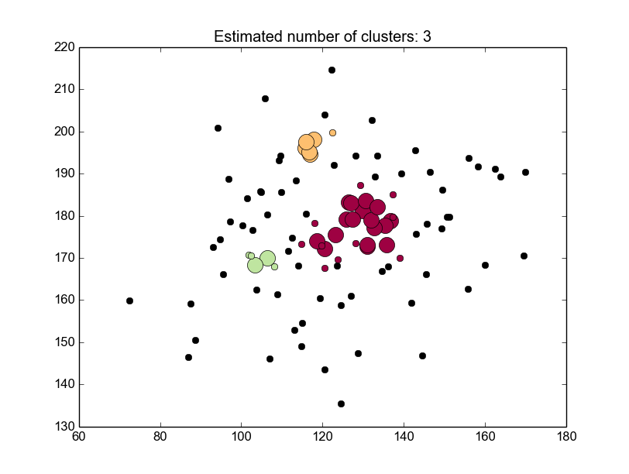
Results: Gerardo Parra

Slide 17
Results: Gerardo Parra
The graph on the previous slide shows the cluster analysis of the Baltimore Orioles player Gerardo Parra
From this clustering we can see that Parra is a very good hitter at any ball in the center of the strike zone, with a large cluster. Additionally, two small clusters appear at the top of the strike zone and the low and inside portion of the strike zone. Parra has been a very good hitter this year, but from the clustering we can see a weakness at the bottom of the strike zone where he becomes more inconsistent.
From the association rules created by the algorithm we can observe in which situations Parra excels:
(85, 90, 'Hit') Instances: 22 : Confidence: 1 support: 0.209523809524
(95, 'Hit', 'four-seam fastball') Instances: 23 : Confidence: 1 support: 0.219047619048
With high confidence we can see that hits for Parra come in the situations when the ball begins at 85 mph and ends at 90 mph and 95 mph four seam fastballs.

Slide 18
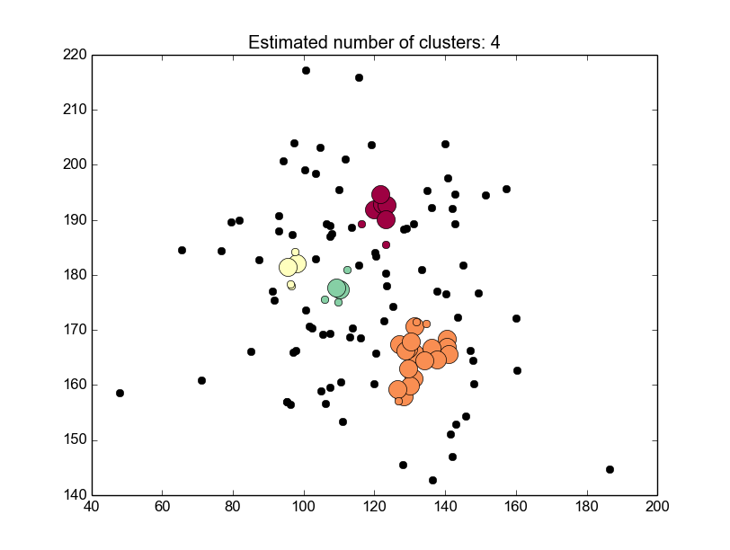
Results: Mike Trout

Slide 19
Results: Mike Trout
Trout is seen as one of the best hitters in the game, which is observable in the cluster analysis of his hits on the previous slide
Using this analysis, an opposing pitcher must avoid the outside corner, center and top of the strike zone
I would suggest that the opposing pitcher pitch mainly to the inside corners

Slide 20
Conclusions
From the results of this experimentation one can reach the conclusion that data analytics, specifically clustering and association analysis can be good tools for the use in major league baseball.
From player scouting to game time decisions, the algorithms appearing here have shown that there is valuable information to be gleaned.

Slide 21
Future Work
Expand this data to each player’s entire career:
  which would produce a much larger sample size
  more interesting and complete analysis can be obtained
  This data would have to be weighted giving more weight to more recent data, because players tend to evolve over the course of their careers
Apply weights to the total number of bases each hit reaches. A players home run zone is more important to be avoided than singles. This could also lead to changes in association rules.
Include specific situations:
  It would be important for pitchers to have a predictive analysis of what pitch to throw in order to induce a double play.

Slide 22
References
[1]T. Pearson, 'History of Major League Baseball From Early Beginnings to Current', Thepeoplehistory.com, 2015. [Online]. Available: http://www.thepeoplehistory.com/baseballhistory.html. [Accessed: 11- Aug- 2015].
[2]D. Mittler, 'Increase in defensive shifts', ESPN, 2015. [Online]. Available: http://espn.go.com/mlb/story/_/id/11060210/defensive-shift-used-all-mlb-teams-espn-magazine http://citeseerx.ist.psu.edu/viewdoc/download?doi=10.1.1.63.1629&rep=rep1&type=pdf. [Accessed: 11- Aug- 2015].
[3]R. Agrawal and R. Srikant, 'Fast algorithms for mining association rules.', Proc. 20th int. conf. very large data bases, VLDB, vol. 1215, pp. 478-499, 1994.
[4]J. Sander, M. Ester, H. Kriegel and X. Xu, 'Density-based clustering in spatial databases: The algorithm gdbscan and its applications', ata mining and knowledge discovery, vol. 2, no. 2, pp. 169-194, 1998.

